Slide 1

Azure Event Grid
Jun 2022

Slide 2
Agenda
Messages and Events
Message brokers
Azure Event Grid use cases
Event Grid on Kubernetes use cases
Demo
Q&A

Slide 3
What we communicate
Message
Intent
Fact
A "typical" message
An event

Slide 4

Messages
Communication that has an intent and expectation.
Message
Command
Query
Job
Value transfer
Request

Slide 5

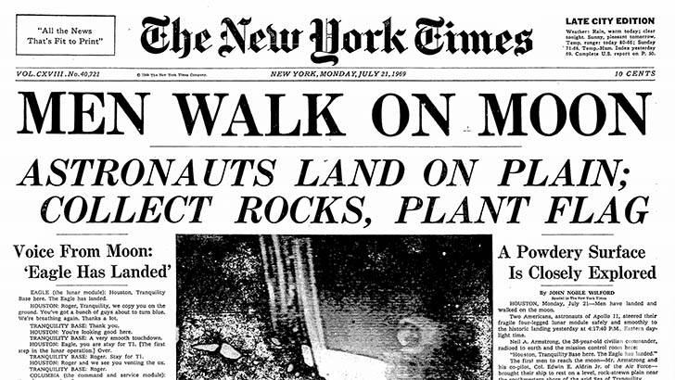
Events
Discrete events
Data point series

Slide 6

Discrete events
Announce facts about a system such as a state change.
Do not convey an intention other than to inform.
It does not carry that much information. It usually carries an Id and possibly the event subject’s URL.

Slide 7

Data point series events
Published as a continued stream of data.
Data stream is analyzed through statistical, ML or some other analytics method.
Data trend is used to gain insights.

Slide 8

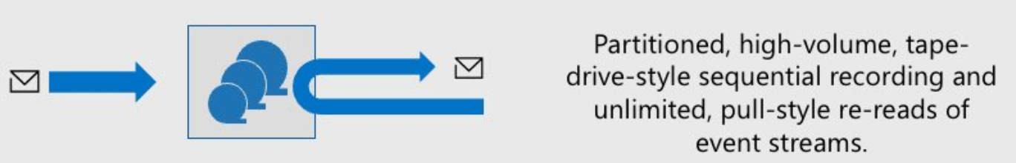

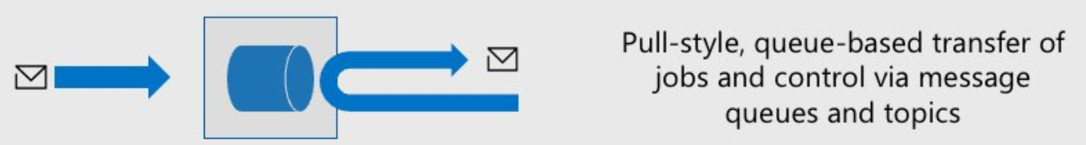

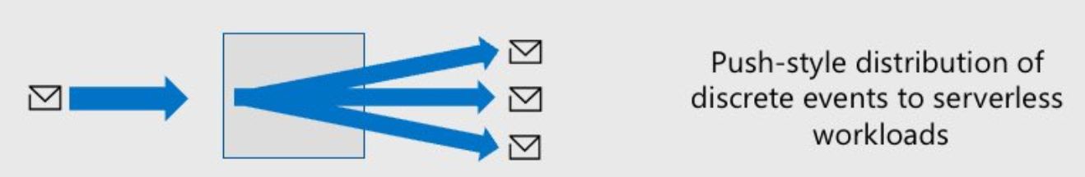

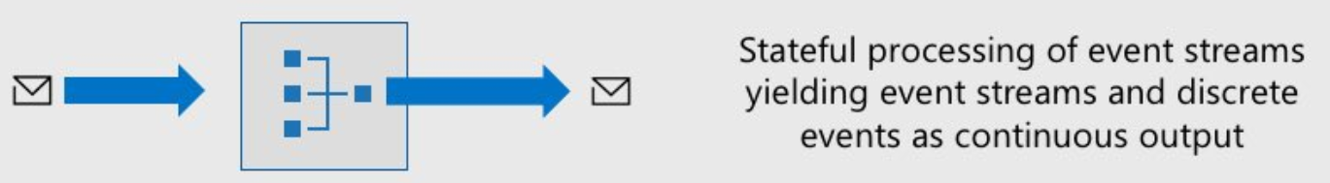
Message Brokers
Choosing the right tool for the right job. One size doesn’t fit all.
Event Streaming
Ingestion and storage of large volume of events, pull-style reads with client-side cursor.
Low latency, high volume event ingestion
Partitioned consumer model
AMQP or Kafka workloads
At-least once delivery
Use cases
Telemetry and distributed data streaming
Messages
Azure Event Hubs
Queue Pub/Sub
For messaging in enterprise applications that require transactions, ordering, duplicate detection, and instantaneous consistency.
Reliable asynchronous message delivery of high-value messages
Message queues and publish-subscribe topics
At least once delivery, Ordered delivery
Transactional, once-and-only-once processing
Use cases:
Order processing and financial transactions
Data Point Series Events
Azure Service Bus
Distribution of Events
Push-style distribution of discrete events to interested subscribers.
Eventing backplane that enables event driven, pub-sub model
Route events coming from Azure services to event handlers or webhook endpoints
Support your own events with custom topics
Use cases:
React to status changes
Discrete Events
Azure Event Grid
Event Stream Processing
Stateful processing of event streams in real-time.
Data Point Series Events
Stateful processing of event streams
Filter, sort, aggregate, and join streaming data over a period of time using SQL
Use cases:
Analyze real-time telemetry from IoT.
Clickstream analytics.
Azure Stream Analytics

Slide 9
Azure Event Grid
Features
Pub Sub event broker
Broker for discrete events
Reliable delivery
Based on open standards
CNCF Cloud Events
Editions
Azure
Kubernetes with Arc

Slide 10







Azure Event Grid at a glance
Event Subscriptions
Order created
API deployed on K8s
subject starts with “account/acct-123224/orders/”
data.itemId = 979
Topic
Event Publisher
Service Bus
subject starts with “account/acct-123224/orders/”
data.itemId = 1265

Slide 11









Sources and handlers
Event Publishers
Event Handlers
Azure services
(System Topics)
Serverless code
Azure Storage
Azure IoT Hub
Azure Media Services
Azure Subscriptions
…
Functions
Serverless workflow and integration
Azure Event Grid
Logic Apps
Customer workloads (Custom Topics and Domains)
Buffering and competing consumers
CloudEvents
Service
Bus
Event Hubs
Storage Queue
Partner services (Partner Topics)
Other services and applications
Hybrid Connections
WebHooks (anything)
Azure Automation

Slide 12
Use Cases
Subscribe to events published by Azure services
Publish your application’s events and enable downstream solutions to subscribe to them
Deliver application events to multiple teams at scale
Subscribe to events published by external Azure Event Grid Partners

Slide 13
Subscribe to events published by Azure services
Feature: Azure Event Grid System Topics
Edition: Azure
As an Azure user, I want to subscribe to Azure services state changes so that my solutions can react to those events.

Slide 14




Azure Event Grid System Topics
Azure services integrated with Event Grid
Azure App Configuration
Azure App Service
Azure Blob Storage
Azure Communication Services
Azure Container Registry
Azure Event Hubs
Azure IoT Hub
Azure Key Vault
Azure Machine Learning
Azure Health Data Services
Azure Maps
Azure Media Services
Azure Policy
Azure resource groups
Azure Service Bus
Azure SignalR
Azure subscriptions
Azure Cache for Redis
Azure FarmBeats
Azure Kubernetes Services

Slide 15
Publish your application’s events and enable downstream solutions to subscribe to them
Feature: Azure Event Grid Topics
Edition: Azure
As an owner of a system, I want to communicate my system's state changes by publishing events and configuring routing of those events so that event handlers, under my control or otherwise, can process my system's events in a way they see fit.

Slide 16
Azure Event Grid Topics
Event Subscriptions
Order created
API deployed on K8s
subject starts with “account/acct-123224/orders/”
data.itemId = 979
Topic
Event Publisher
Service Bus
subject starts with “account/acct-123224/orders/”
data.itemId = 1265

Slide 17
Deliver application events to multiple teams at scale
Feature: Azure Event Grid Domains
Edition: Azure
As an owner of a system, I want to announce my system’s state changes to multiple teams in a single tenant so that they can process my system’s events in a way they see fit.

Slide 18

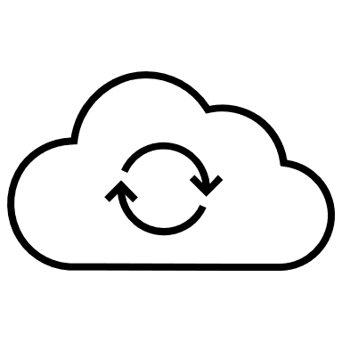













Azure Event Grid Domains
Event Domain
Event subscriptions
Domain Topic for Red Org.
Company A application
Domain Topic for PURPLE Org.
Company A application
Topic: Red
Topic: PURPLE
Topic: GREEN
…
Event Publisher
Event Grid domain endpoint
Domain Topic for GREEN Org.
Domain Event subscription
Company A application

Slide 19




RBAC roles to use/manage domain topics
Publisher:
Provisions domain topics and event subscription(s).
Set ups RBAC role for end-user/group/app to either Contributor or Reader.
If Contributor → user can create additional event subscriptions and manage them.
Publisher is still the owner who pays the bills.
Event Subscription(s)
Publisher
Domain Topic for RED Co.
RBAC Roles:
Reader
Contributor
Tip: Balance easy management with ability to control cost.
RED Co. user / service principal / group
Azure Active Directory

Slide 20
Subscribe to events published by external Azure Event Grid Partners
Feature: Azure Event Grid Partner Events
Edition: Azure
As an owner of a multi-tenant SaaS system, I want to communicate my system's state changes using a method that segregates publisher and subscriber concerns so that subscribers own their own topics and event subscriptions.

Slide 21



Azure Event Grid Partner Events
Third-party publisher (partner) resources
Subscriber resources
Channel for organization X
Partner Topics
organization X resources
Channel for organization Y
organization y resources
Partner Events Namespace
Channel for organization Z
organization z resources
…
Note: Partner topics are provisioned by partner.
Channel for organization n
organization n resources

Slide 22







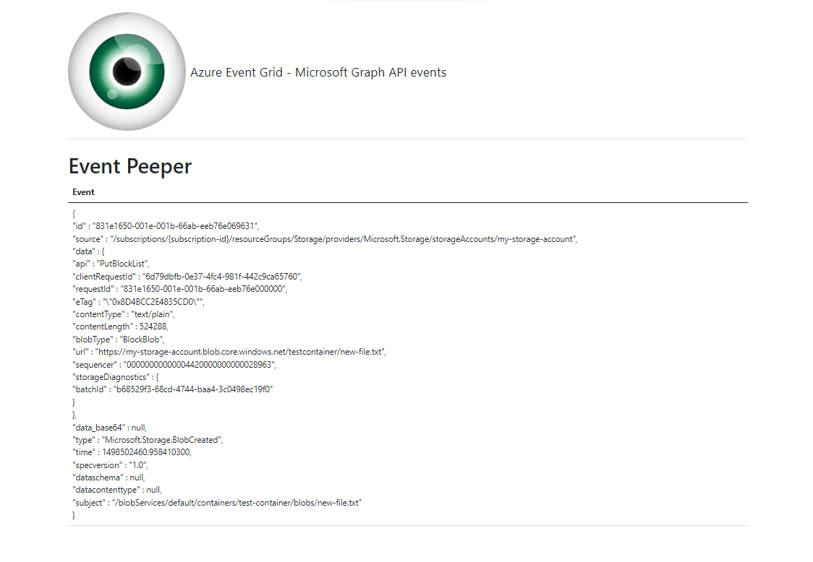


Azure Event Grid Partner Events with MS Graph API
User Updated
<update user>
Partner Topic
Event subscription
Azure AD Admin
User
MS Graph API
Web application
Azure AD
Events source
Partner publisher
Event Grid customer resources
Event handler

Slide 23
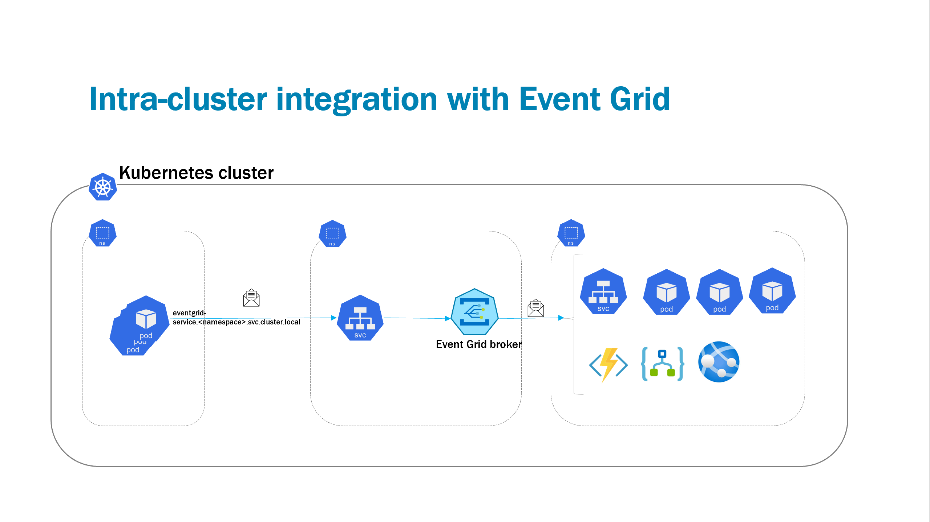
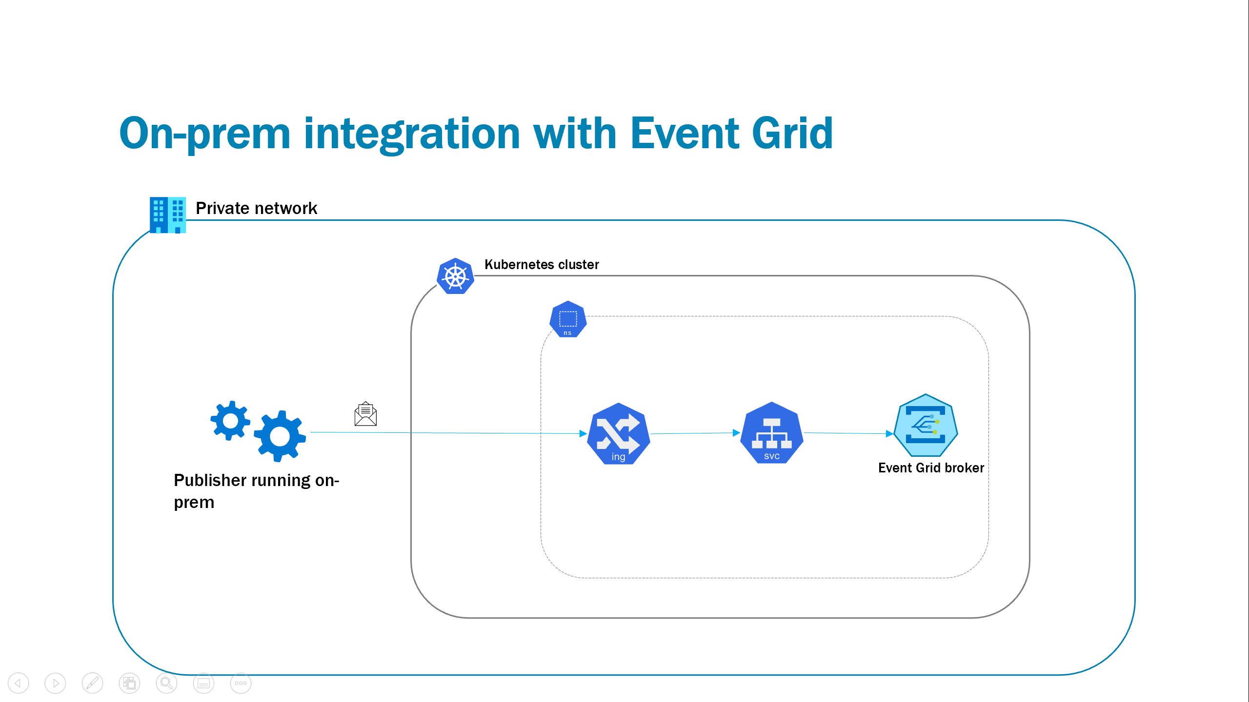
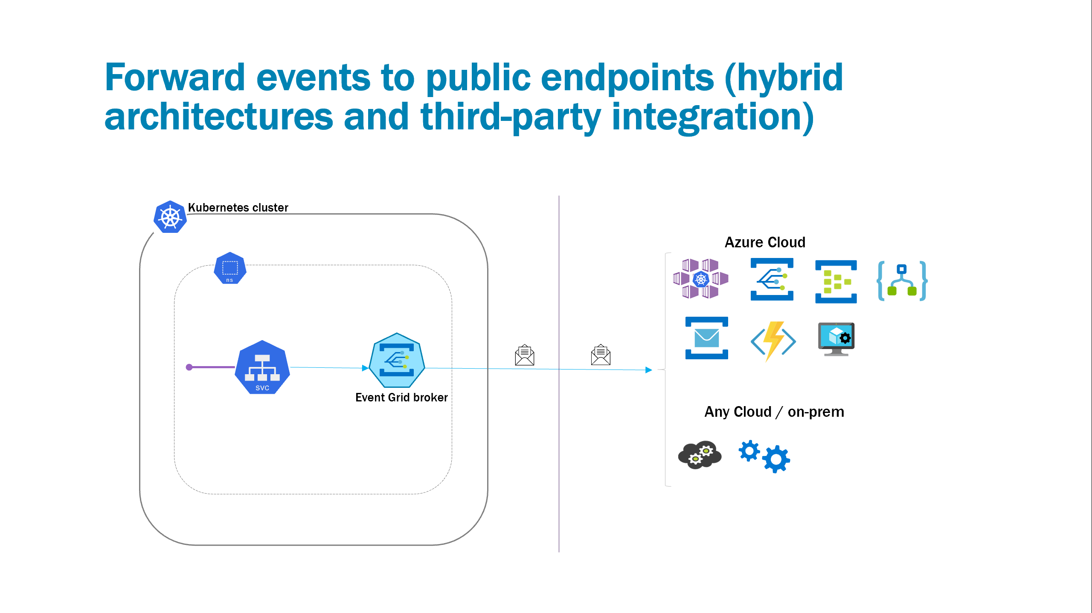
Event Grid on Kubernetes use cases
Intra-cluster integration
On-prem integration
Forward events to public endpoints (hybrid)

Slide 24
Demo
Speaker name

Slide 25
Q&A

